Slide 1
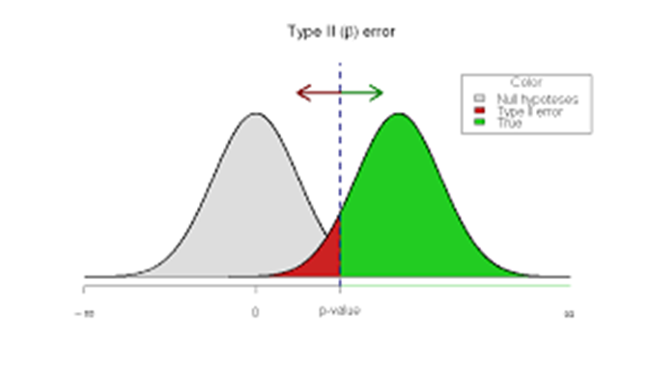
Bringing Power to Psychological Science
Pam Davis-Kean
Methods Hour
January 20, 2017

Slide 2
I collected my data, I ran my analyses, and nothing is significant. What do I do?
Common Question
Notes:
This occurs be our focus is not on answering our questions but to find something we can publish. Our focus should be on the science and how to adequately test that science—not on searching through data to find significance and publish it. We are at a point in our science where we are spending time and money on researching what are essentially random findings in the literature.

Slide 3
Recommendations for Strong and Rigorous Research
Know the effect size of the phenomena you are testing
Know your research questions
Run power analyses based on questions being asked in your study
Collect appropriate sample size to power the study
Analyze your data
Report your findings

Slide 4
Know the effect size of the phenomena you are testing

Slide 5
How do you find this information:
Confirmatory
you determine this from the literature
Meta-analysis
Problem: small n’s inflate EF=winner’s curse
Winner’s curse
the phenomenon whereby the ‘lucky’ scientist who makes a discovery is cursed by finding an inflated estimate of that effect.
occurs when thresholds, such as statistical significance, are used to determine the presence of an effect and is most severe when thresholds are stringent and studies are too small and thus have low power. (Button, et al., 2013)

Slide 6
How do you find this information:
Exploratory
Cohen’s estimates of large or small or set a rate based on similar phenomena (Psych variables are often small effects).
0.2 be considered a 'small' effect size,
0.5 represents a 'medium' effect size
0.8 a 'large' effect size.
This means that if two groups' means don't differ by 0.2 standard deviations or more, the difference is trivial, even if it is statistically significant.

Slide 7
Collect appropriate sample size to power the study

Slide 8
What can you reliably detect with n = 20?!
To have 80% power, you need to be studying an effect with d > .90.!
We tested some "obvious” hypotheses on MTurk (N = 697) to get estimates of true effect sizes.!
Courtesy of Simmons, Nelson, Simonsohn, 2013

Slide 9
What can you reliably detect with n = 20?
Men are taller than women (n = 6)
People above the median age report being closer to retirement (n = 9)
Women report owning more pairs of shoes than do men (n = 15)
Courtesy of Simmons, Nelson, Simonsohn, 2013

Slide 10
What can’t you reliably detect with n = 20?
People who like spicy food are more likely to like Indian food (n = 26)
Liberals rate social equality as more important than do conservatives (n = 34)
Men weigh more than women (n = 46)
People who like eggs report eating egg salad more often (n = 48)
Smokers think smoking is less likely to kill someone than do non-smokers (n = 144)
Courtesy of Simmons, Nelson, Simonsohn, 2013

Slide 11
Rule of thumb: N = (4/EF)² (for power = .8 for a 2-tailed .05 test)
Effect Size (EF) | N per group | (4/EF)²
.1 | 1571 | 1600
.2 | 394 | 400
.3 | 176 | 178
.4 | 100 | 100
.5 | 64 | 64
.6 | 45 | 44
.7 | 34 | 33
.8 | 26 | 25
.9 | 21 | 20
1.0 | 17 | 16
Courtesy of Don Hedeker, UIC

Slide 12
Important issues
Each statistics has its own power calculation
G-Power only has basic mean differences and correlation statistics
For more complex, will have to get code

Slide 13
I’m totally freaked out!
We should all be a little freaked out by how we have been doing our science
However, by considering power you can make decisions about your analyses
Reduce variables
Reduce amount of groups
Add Within measure to Between designs
Collect more data or connect data across labs
Seek out existing data sets with large samples

Slide 14
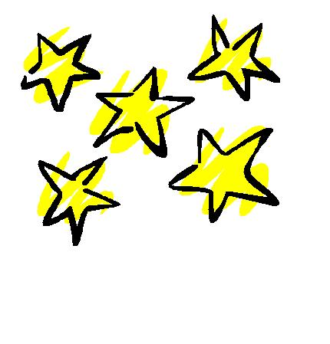
Stop searching for Stars and start searching for Power
N=1600

