Slide 1
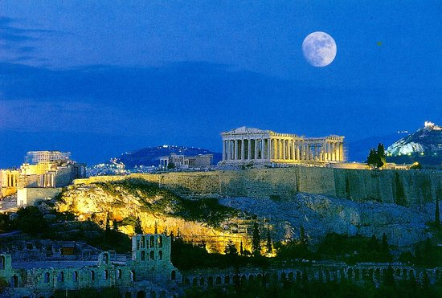
Greece’s Solidarity Movements in the Wake of the Crisis
Juan Miranda Ruiz
University of Puerto Rico, Rio Piedras

Slide 2
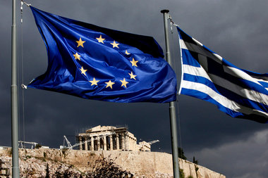
Greek Crisis; a Quick Summary
1. Market Ideology; Political
Independence and Economical Dependence
2. Greece’s Economic History:
Debts and Defaults
3. Diaspora and
Media: A Tragedy

Slide 3

Born in the
crisis
Non profit Volunteer work
Mostly, not legally
registered
Solidarity Movements

Slide 4
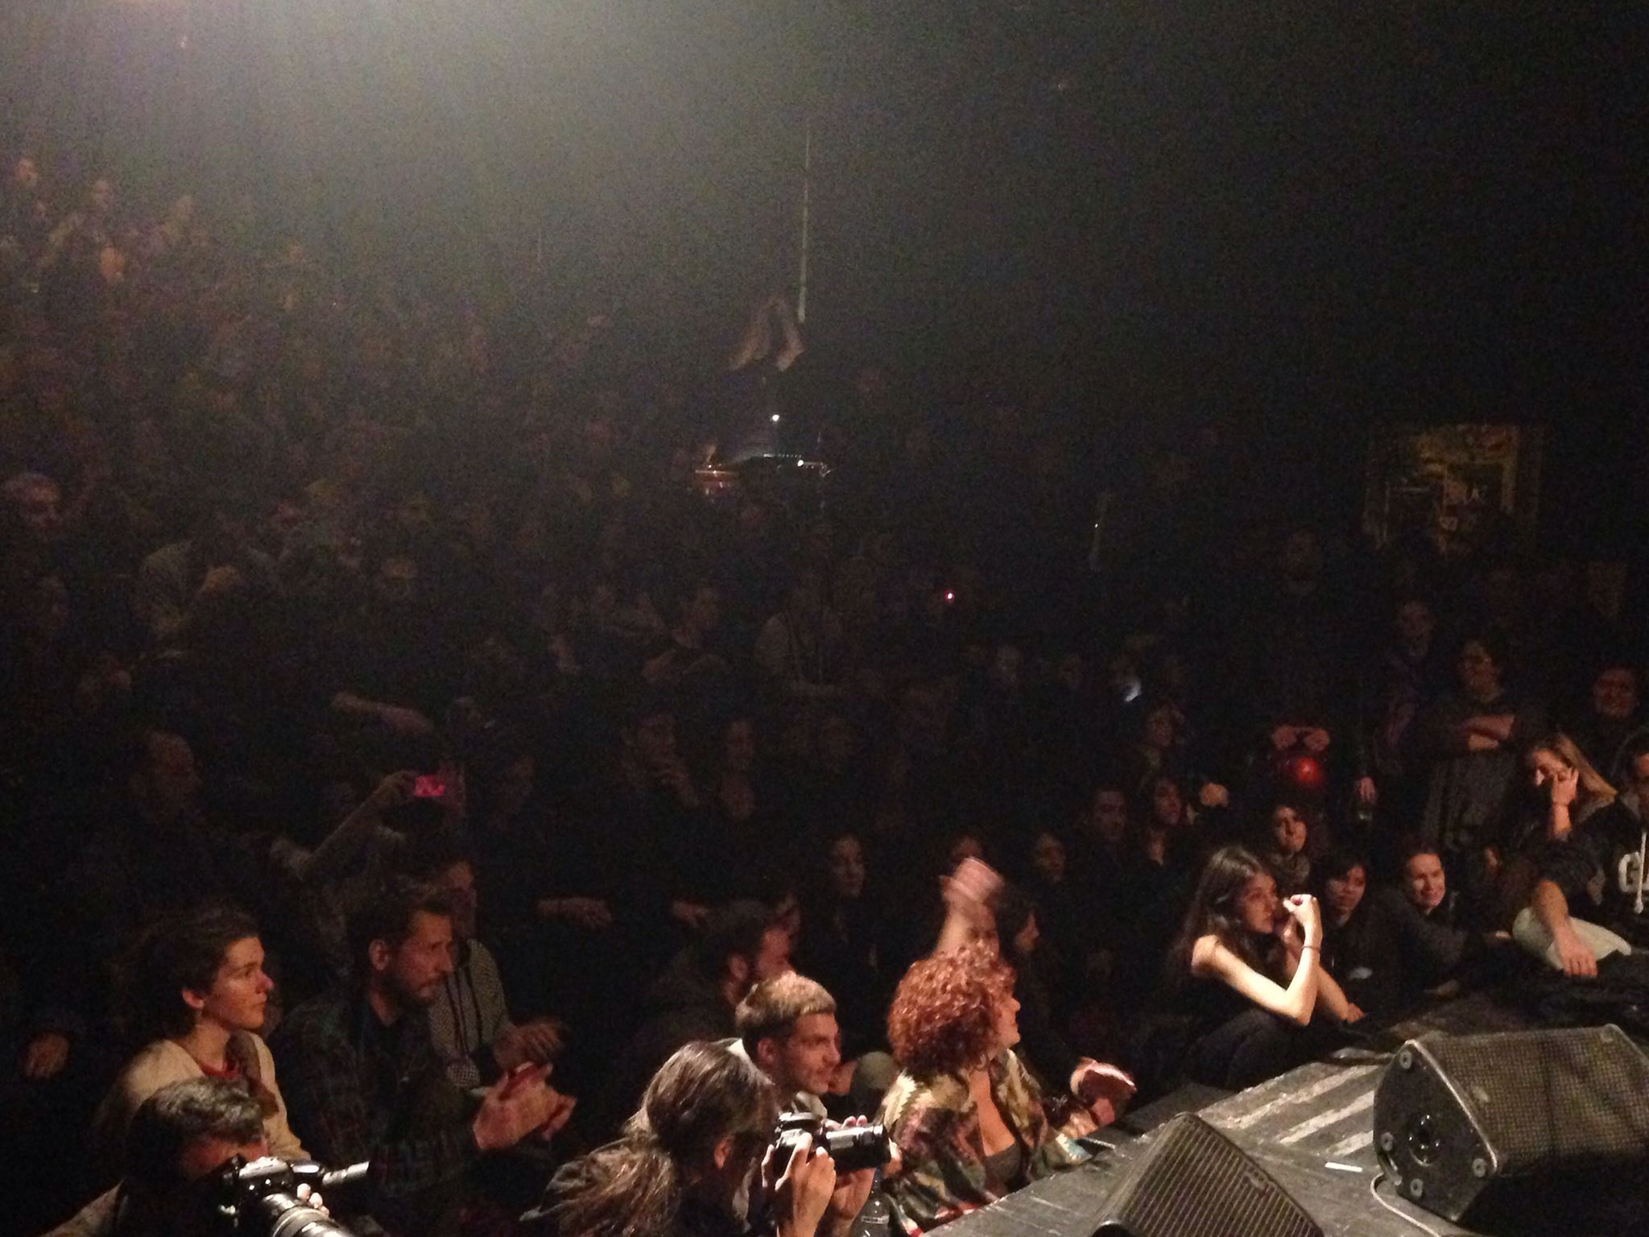
Categories by service provided:
1. Art and Culture
Free Front self Theater

Slide 5
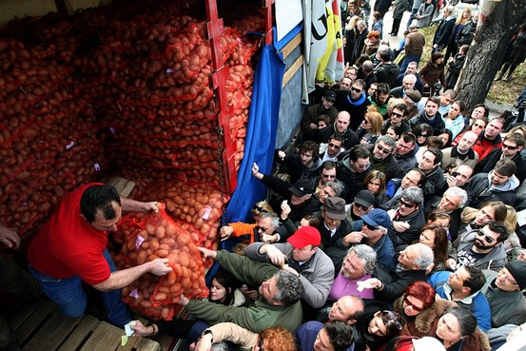
Potato Movement
Let’s spend together
2. Alternative Economies and Local Exchange Trading Systems

Slide 6
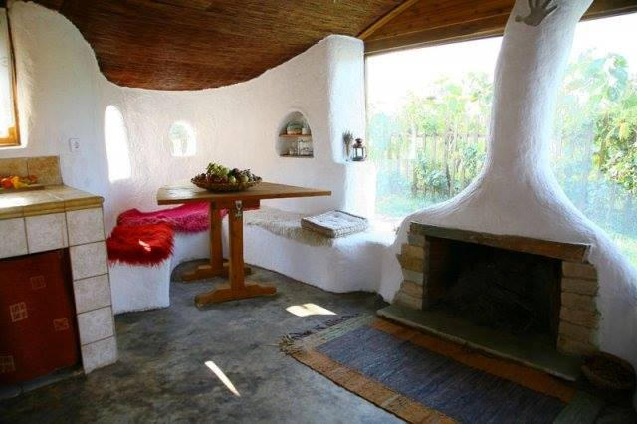
3. Enviroment, Nature and Ecology
Building with Earth

Slide 7

4. Human rights
Group of Lawyers for the Rights of Migrants and refugees

Slide 8
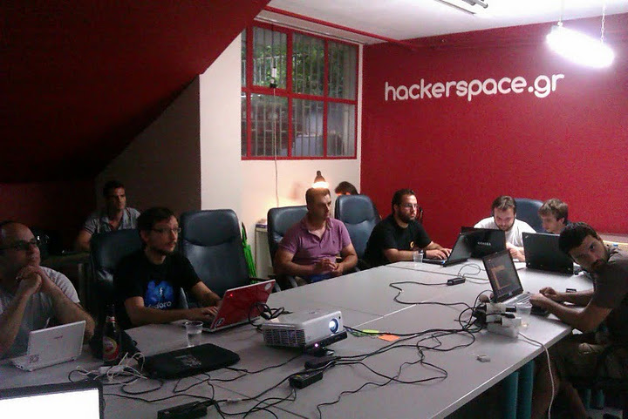
5. Information Technology
Hackerspace

Slide 9
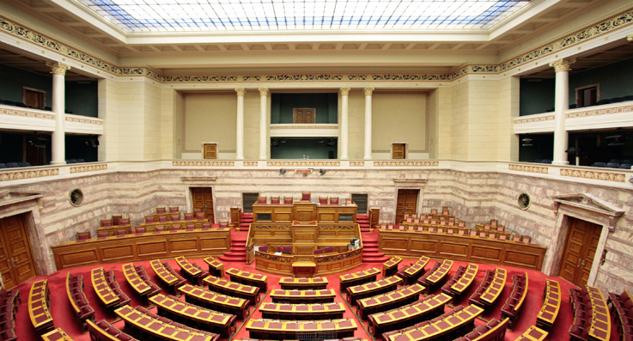
6. Neighborhood assemblies and Democracy Projects
Vouliwatch

Slide 10

7. Education
Sunday School for Immigrants

Slide 11

8. Media and Communications

Slide 12
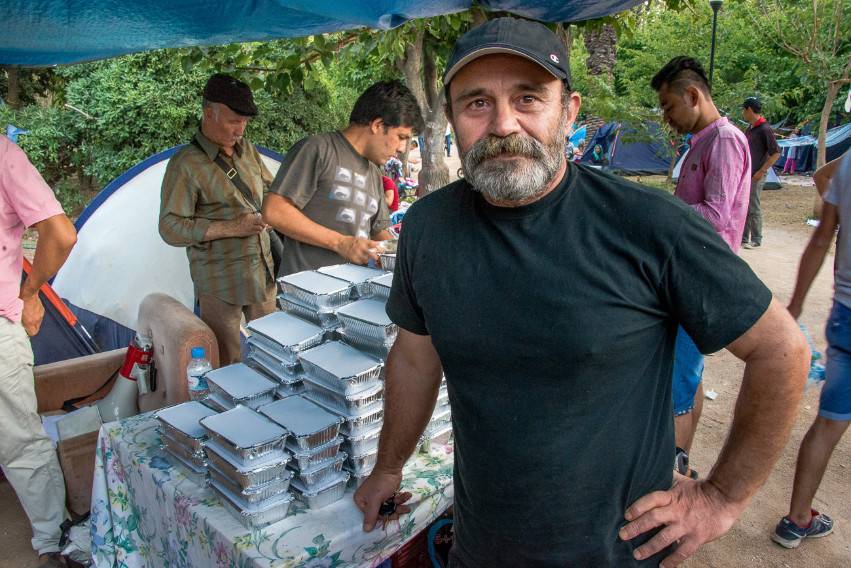
9. Collective Kitchens
The Other Person

Slide 13
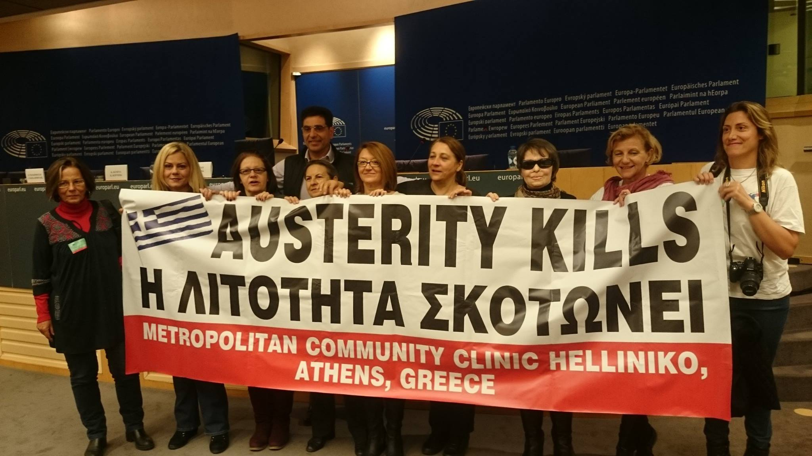
10. Health

Slide 14
Thank You!

