Slide 1
Globalization: Challenges and Opportunities

Slide 2
Globalization: What is it? Why does it matter? What does it have to do with me?

Slide 3
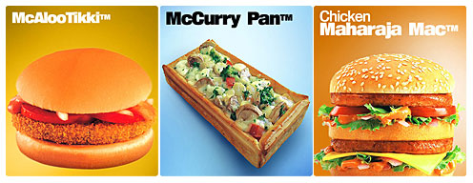
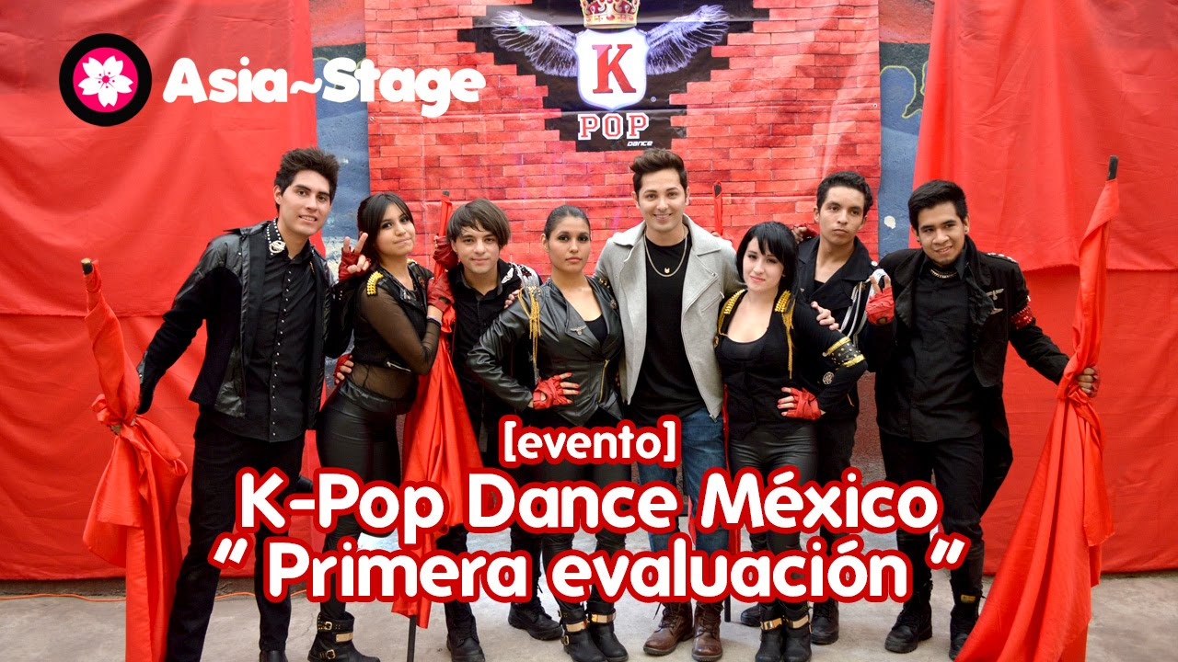
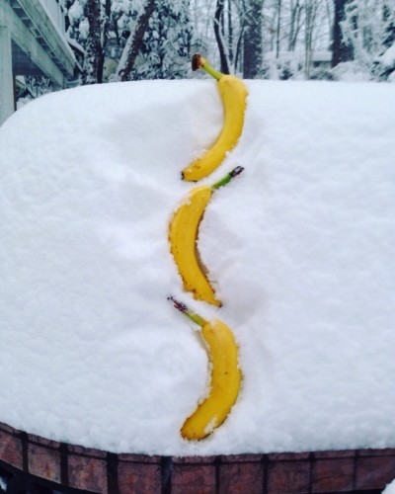
What do you see? What do you think?
What do you wonder?
What do these images have in common?

Slide 4
Globalization
Turn and Talk… what does it mean to you?

Slide 5
Globe
What does this word mean?

Slide 6
Global
What does this mean?
What does it mean when we add AL to a noun?
Person ------ Personal
Season ------ Seasonal
Tropic ------ Tropical

Slide 7
Globalize
What does this mean?
What does it mean when we add IZE to an adjective?
Industrial ------ Industrialize
Personal ------- Personalize
Central ------ Centralize

Slide 8
Globalization
What does this mean?
What does it mean when we add ATION to a verb?
Industrialize ------ Industrialization
Criminalize ------- Criminalization
Centralize ------ Centralization

Slide 9
Globalization
What does it mean?
Put the pieces together!

Slide 10
Globalization… some definitions:
The trend of increasing interaction between people or companies on a worldwide scale due to advances in transportation and communication technology
Globalization is primarily an economic process of integration that has social and cultural aspects, but conflicts and diplomacy are also large parts of the history of globalization.
The process by which businesses or other organizations develop international influence or start operating on an international scale.

Slide 11
Globalization… more definitions:
Globalization is a process of interaction and integration among the people, companies, and governments of different nations, a process driven by international trade and investment and aided by information technology.
This process has effects on the environment, on culture, on political systems, on economic development and prosperity, and on human physical well-being in societies around the world.

Slide 12
Other key concepts…
Integration: the combination of two or more things in order to become more effective or to achieve a new goal
Interaction: a kind of action that occurs when two or more objects, forces, groups, people, etc. have an effect upon one another
Globalization is about both of these at a worldwide scale.
What are some examples of integration and interaction?

Slide 13
Is globalization a new thing?
Turn and talk… what do you think?

Slide 14
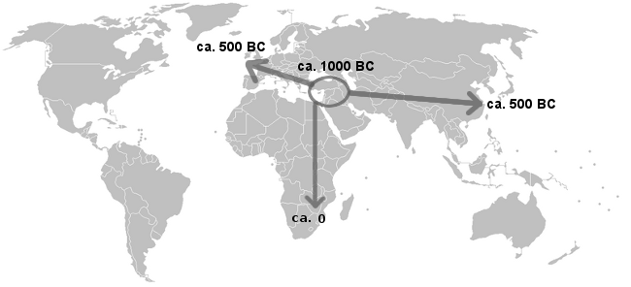
The Spread of Iron
Iron developed independently in sub-Saharan Africa as early as 900 BCE
Where did iron seem to be used first?
Why do you think it took a while for it to spread?
When do you think iron reached the Americas? Why?
What limited this early globalization?

Slide 15
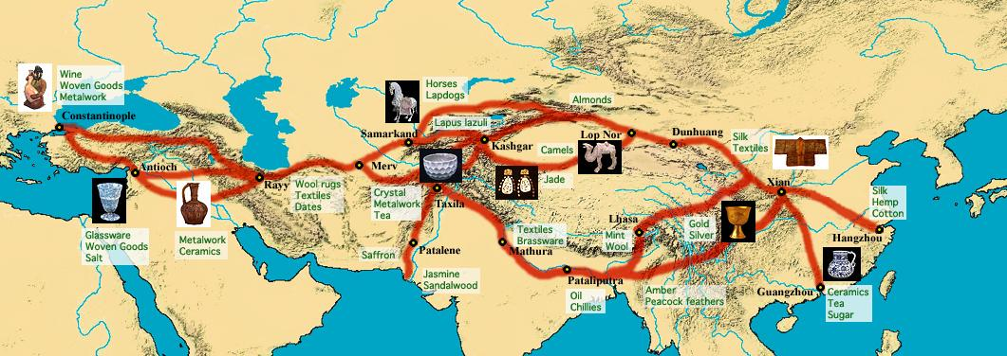
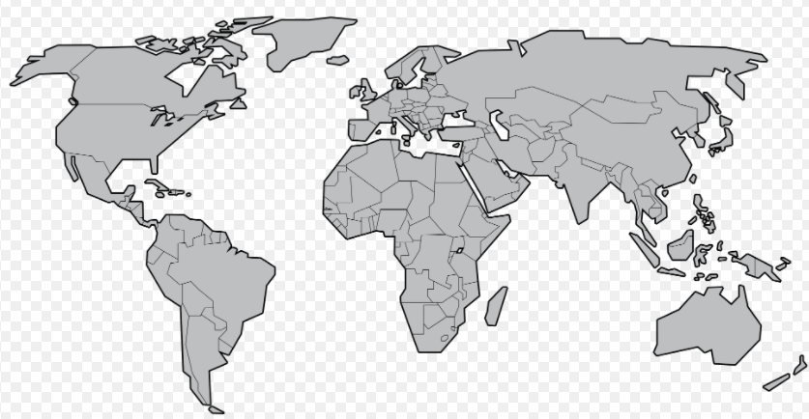
http://hayforum.blogspot.com/2012/06/great-silk-road.html
Look at this map of the Silk Roads showing some of the different products being traded (around 114 BCE – 1450s CE)
Turn and Talk:
What kinds of goods were being traded?
How is this an example of globalization?
What parts of the world did this trade NOT reach? Why?

Slide 16
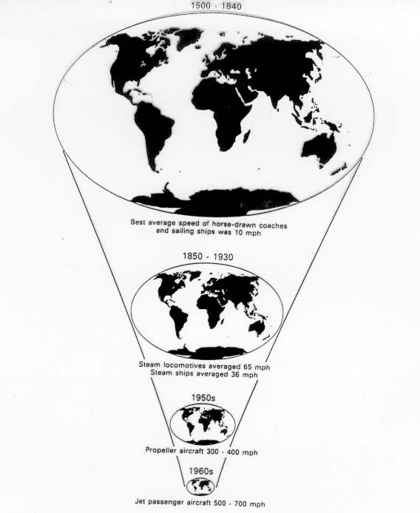
Turn and Talk:
How do you think transportation technology changed globalization?

Slide 17
Turn and Talk:
How do you think communication technology changed globalization?
Is this change still happening?

Slide 18
So what is new?

Slide 19
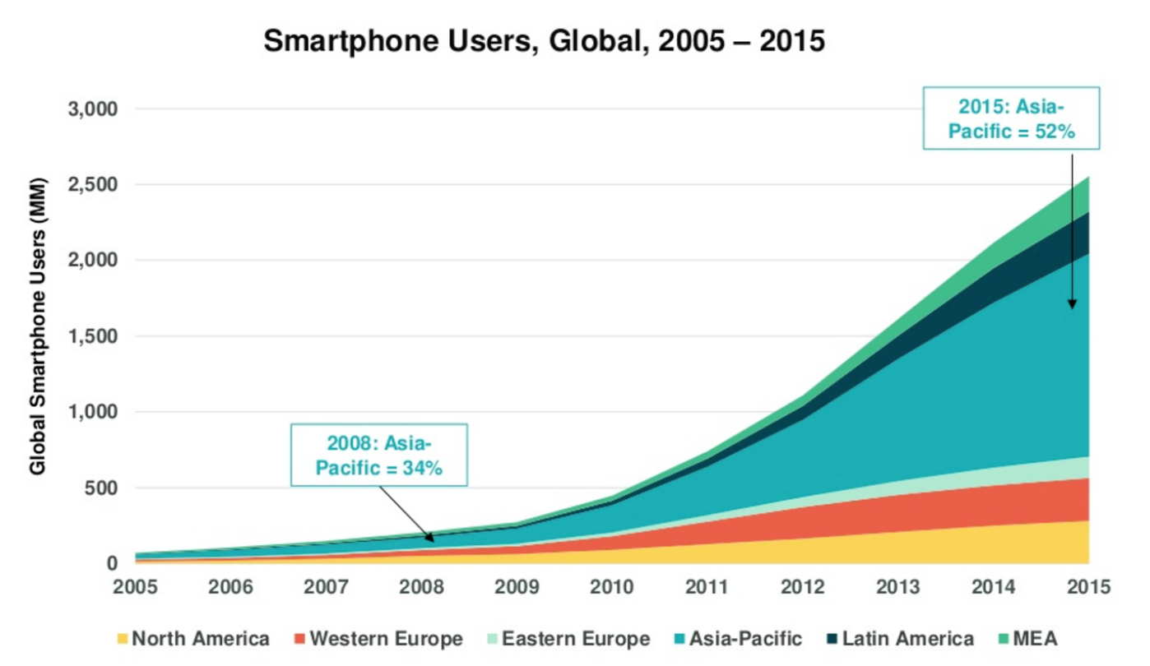
What changes might result from the growth of smartphones?
How can a new technology change people’s lives?
How might the world change?

Slide 20
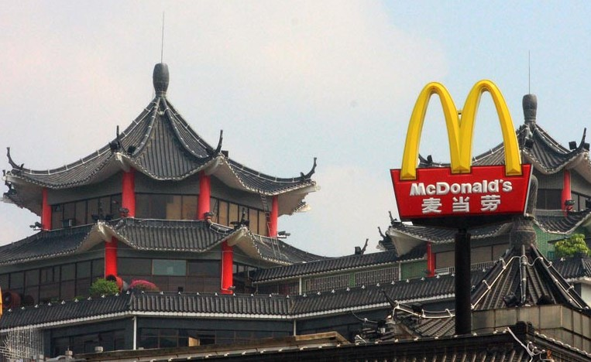
What do you see?
What do you think?
What do you wonder?
What has been “globalized” in these pictures?

Slide 21
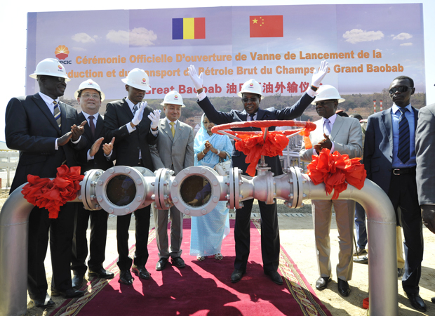
What do you see?
What do you think?
What do you wonder?
What has been “globalized” in these pictures?

Slide 22
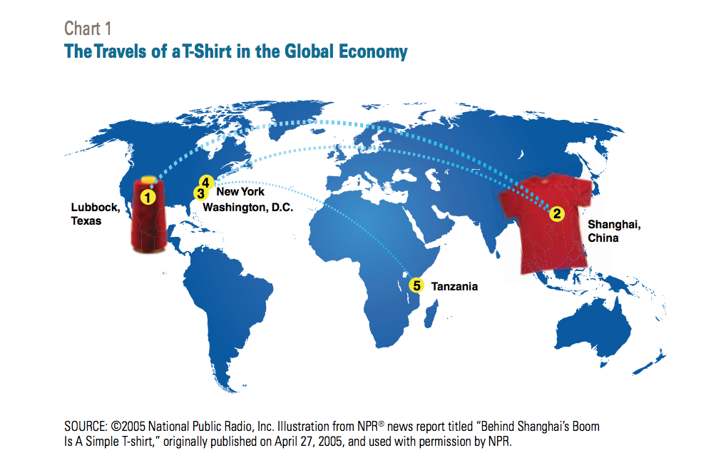
Cotton grown in Texas
Shipped to China where it is turned into a shirt
Shipped back to the US to distribution center in NY
Shipped to DC where it is sold and worn
Eventually donated and shipped to Tanzania where it is re-sold
Turn and Talk:
Are you surprised by anything in this diagram?
Identify three different objects that you are wearing or carrying and figure out where they were manufactured.
What kinds of materials were used?
Where do you think these materials are from?
Do you think a lot of things we use have a global story like T-shirts?

Slide 23
Globalization Frayer Model
Definition | Characteristics
Examples | Non-examples
Globalization

Slide 24
Globalization Frayer Model
Definition | Characteristics
Examples | Non-examples
Globalization

Slide 25
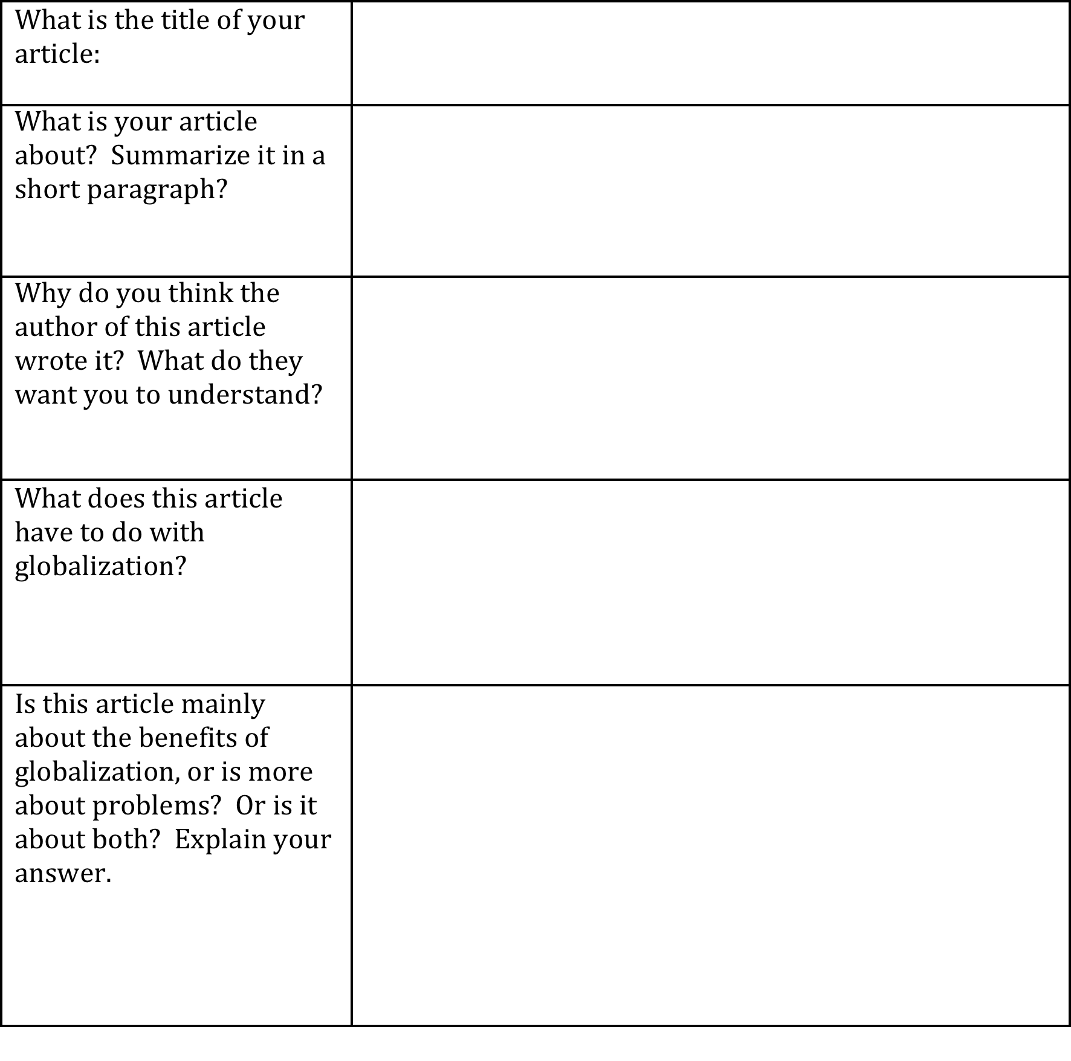
Guided Reading Activity

Slide 26
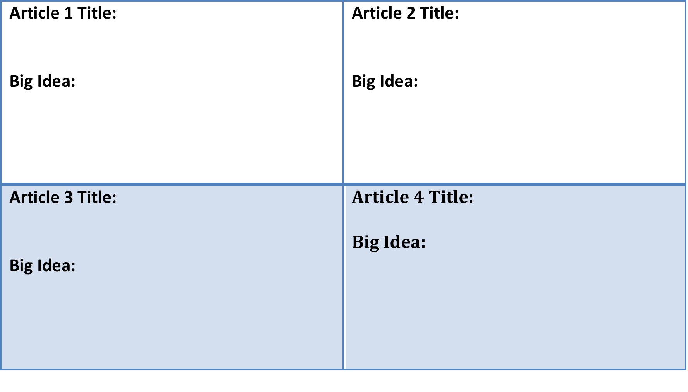
Opportunities / benefits:
Challenges / problems:

Slide 27
How are you shaped by globalization?
Exit Pass… In complete sentences, explain how globalization has affected you in both good and bad ways. Provide an example of how you have benefitted from globalization, and also provide an example of a challenge it is presenting you.

