Slide 1
Identity and Globalization
Challenges and Opportunities continued

Slide 2
Exploring identity:
Take a moment and Stop and Jot:
How do you describe yourself?
Jot down a list of words and phrases that come to mind when thinking about your own identity.
Form into groups of 3 or 4. Share ideas from your lists.
As a group, develop a list of CATEGORIES into which your different identity words can be grouped.
For example, GENDER and GRADE LEVEL are two categories into which different terms might fall.
Be ready to share!

Slide 3
What is identity?
The entire set of characteristics by which a thing or person is recognized or known.
The set of behavioral or personal characteristics by which an individual is recognizable as a member of a group.
https://www.tolerance.org/professional-development/social-justice-standards-unpacking-identity

Slide 4
Our identity consists of the various characteristics we use to categorize and define ourselves and the various characteristics that are constructed by those around us.
Sometimes people only think of identity as those visible characteristics of a person, but sometimes our identity characteristics are invisible.
https://www.tolerance.org/professional-development/social-justice-standards-unpacking-identity

Slide 5
Read the following identity characteristics list:
Gender
Ethnicity
Race
Religion
Socioeconomic status
Language
Marital/relationship status
Parent or childless
Family size and composition
Sexual orientation
Education
Career
Which of these characteristics are visible, and which are invisible?
https://www.tolerance.org/professional-development/social-justice-standards-unpacking-identity

Slide 6
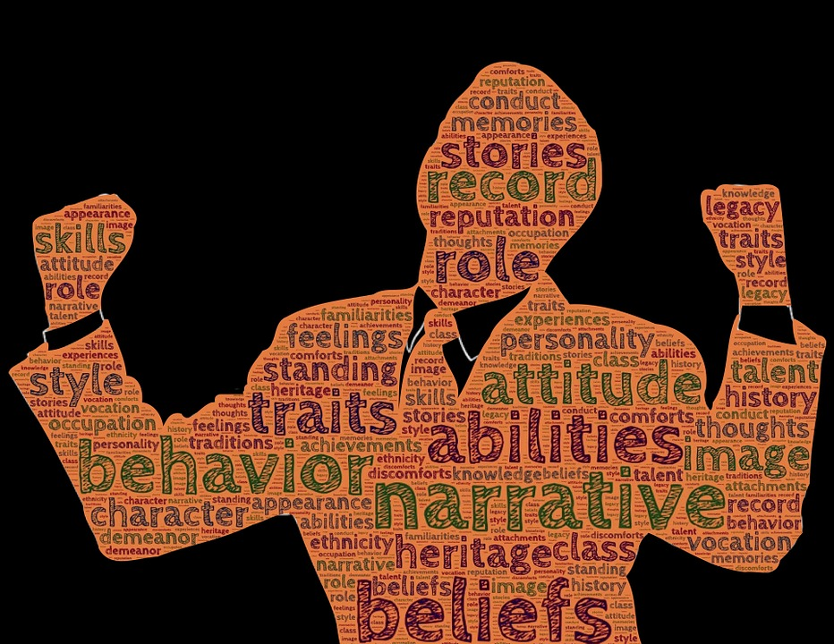
How we see ourselves
Turn and Talk:
When can the different
forms of identity on this diagram come into conflict with each other?
Does the way you see yourself ever clash with the way others see you?
Has this ever happened
to you? How did you
respond?
Identity
How we see ourselves in relation to others
How others see us

Slide 7
Politics and Identity… are they connected?
So what is politics?
Turn and Talk about what the word “politics” means to you.

Slide 8
Definitions of Politics
The activities associated with the governance of a country or other area, especially the debate or conflict among individuals or parties having or hoping to achieve power.
A person's opinions about the management of government.
How power and decision making happens in a nation, society, or other social institution or organization.
How people relate to and think about power and authority.
Stop and Jot: What are some political issues or topics that are important to you?

Slide 9
Politics of identity
Small Group Conversations:
How do you see yourself in relationship to your government?
To politics in general?
To people who have power in different ways?
To political beliefs or philosophies?
Liberal or conservative? Left, right, or in the middle?
Democrat, Republican, Green, Independent, Socialist, something else?
Very political or not really interested in politics, or somewhere in-between?
To political conflicts or issues?
Puerto Rico and the US?
US involvement in Syria?
Gun control?
Local or regional political issues?

Slide 10
Globalization again!
Reflect back to the lesson on Globalization.
What is it?
Quickly discuss this in your group.

Slide 11
So what does globalization have to do with power, politics, and identity?

Slide 12
Are there winners and losers in different examples of globalization? What does that have to do with identity?

Slide 13
Image Analysis
Now you will see 8 different images. Prepare to take notes on each one and share your reflections.
For each image, consider what the image has to do with spreading global culture, power, or economics.
Also think about how this example might connect to the ways that people see themselves or are seen by others (identity!).
Quickly discuss your analysis of the image with a partner, jot down some ideas, and be ready to share!

Slide 14
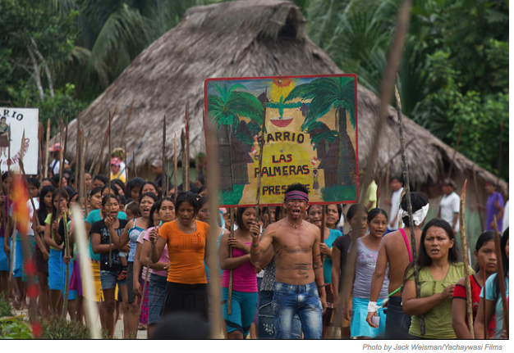
Indigenous Amazonian protestors
Photo by Jack Weisman/Yachaywasi Films
A scene from the documentary showing Peru's Indigenous Amazonian people protesting to save their rainforest.
http://www.earthisland.org/journal/index.php/elist/eListRead/a_gripping_chronicle_of_amazonian_tribes_struggle_against_Peru/

Slide 16
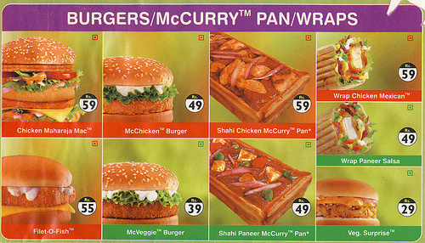
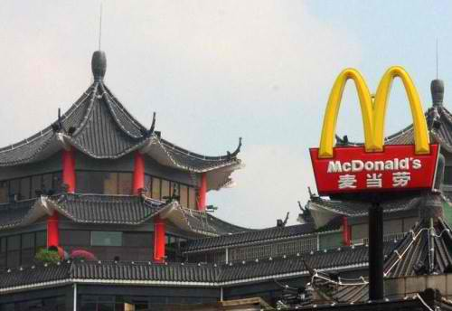

Slide 22
Discussion Questions
Take turns summarizing the article you each read, then as a group, discuss the following (and be prepared to share!):
What are some ways that globalization can harm the identities of local communities and people?
What might we lose because of globalization, and what might can we gain?
What are some of the ways that globalization can have positive impacts on identity?
How can we maintain our cultural identities and still learn from and enjoy other cultures?

Slide 23
Who are you?
Exit Pass: Take a moment and reflect in writing on your own identity as an individual and as a member of a global community, responding to the questions below:
How is your identity local and connected to your culture and community?
How is your identity connected to the world and global culture?
How do you balance these identities out?

