Slide 1
Identity in A globalIZED Pakistan ~ Salman Adil Hussain

Slide 2
Pakistan - Questions
Write down first impressions: What comes to mind when you think about Pakistan? (These could be single word descriptions written on sticky notes that the instructor collects and posts on the wall.)
Why do we know what we know, and don’t know other things?

Slide 3
Where is Pakistan?
What geographical region is Pakistan in? (Middle East, Islamic world, Third World etc.)
What are its neighboring countries?
What are its relations like with its neighbors?
What regions exist in Pakistan?
What is the ethnic/religious composition of Pakistan?
What languages are spoken in Pakistan?
What is the total population of Pakistan?
How much urban and rural?
What is the most populous city in Pakistan?

Slide 4
What is the form of government in Pakistan?
Any political leaders, past or present?
What do we know about the arts, music, sports in this country?
What important historic events took place?
When did it gain independence?
From whom?
Major changes?

Slide 5
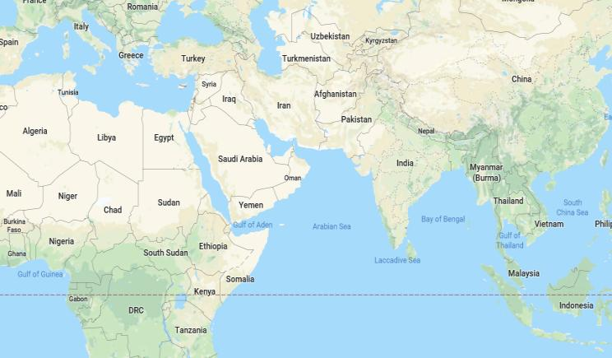

Slide 6
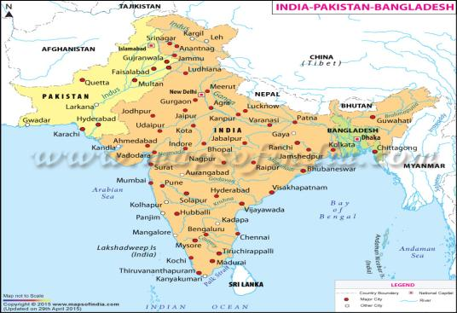
Pakistan in South Asia

Slide 7
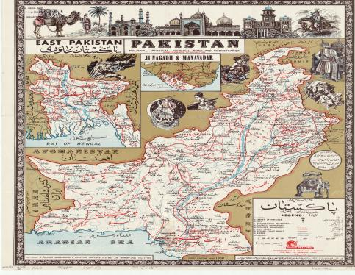
Pakistan between Partitions
A map of Pakistan c. 1060 showing its East Wing, which became Bangladesh in 1971.

Slide 8
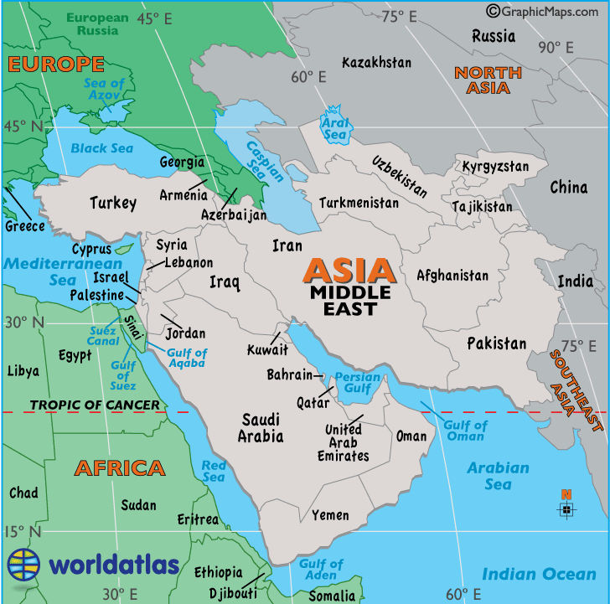
Pakistan in Middle East – did it move?

Slide 9
Region
What is a region?
What kinds of regions are there?
Region within a country (East Coast of US.)
Region including several countries based on geography (continent) or on assumptions of cultural/racial/religious/linguistic affinity (Middle East)
Metropolitan regions (The city and its suburbs)

Slide 10
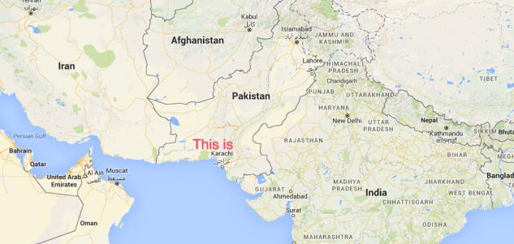
Karachi

Slide 11
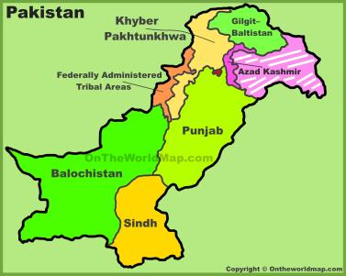
Present-day Administrative map of Pakistan

Slide 12
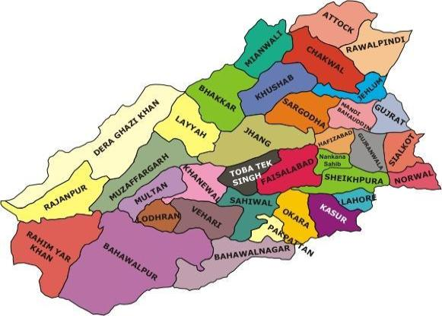
Punjab Districts

Slide 13
Exercise
Look up information about this city: Where, how many people, population composition, different areas within the city, class differences can be gleaned by searching for the kinds of amenities available and at what price [look up the currency conversion rate and average salaries to understand what costs what and how expensive something is.]
OR
Write a description of Pakistan’s largest city, Karachi, based on publicly available information.

