Slide 1
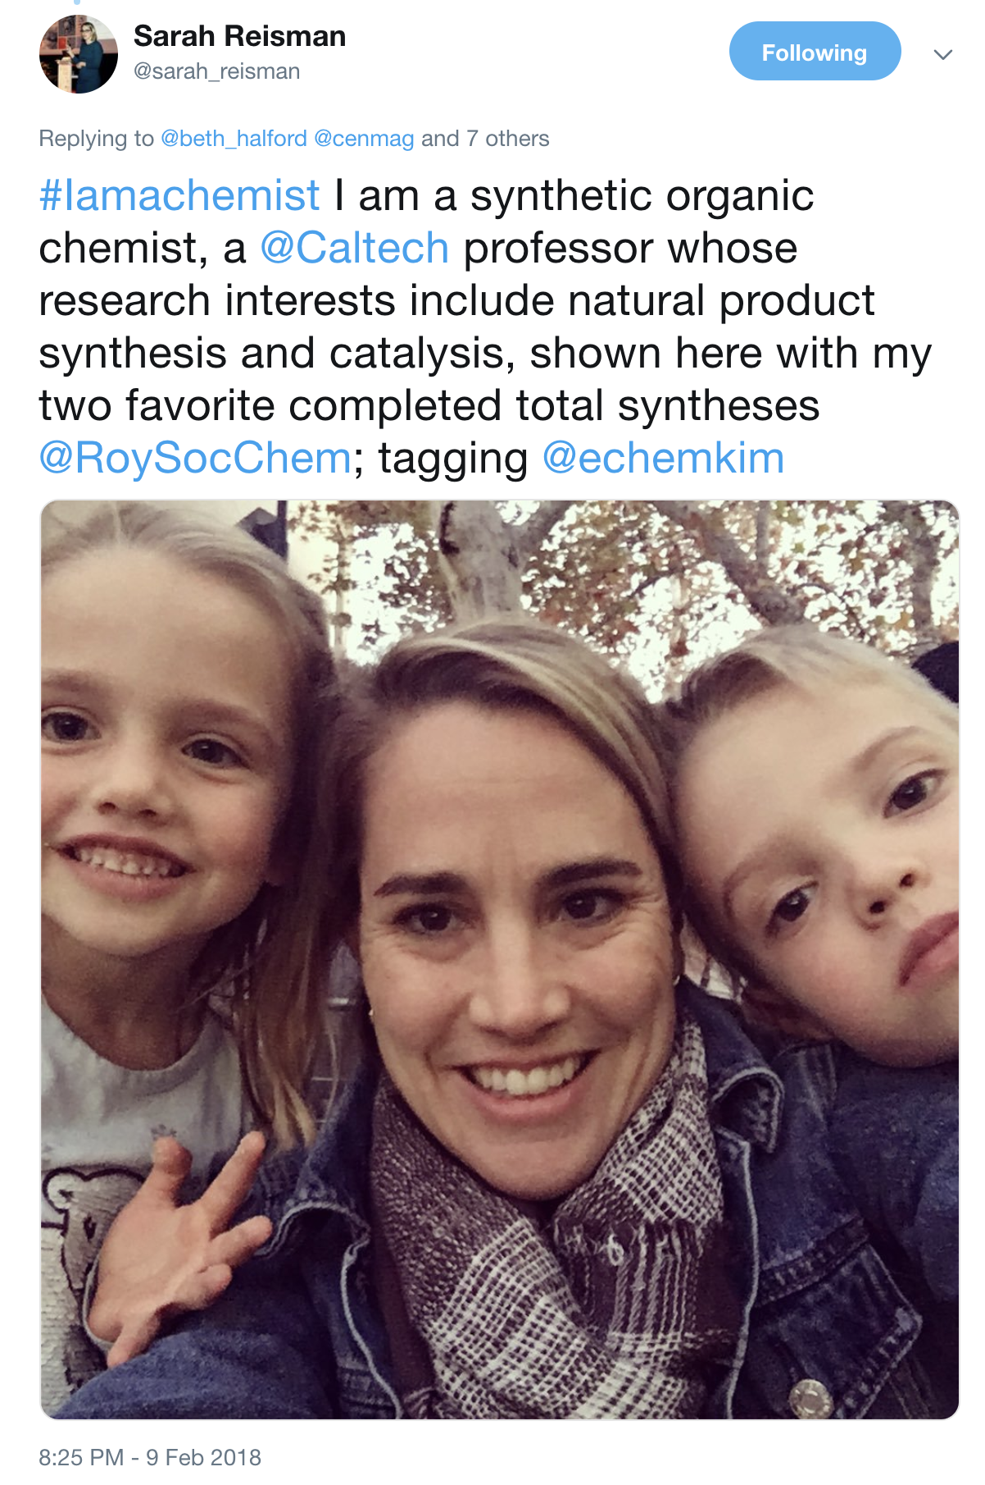
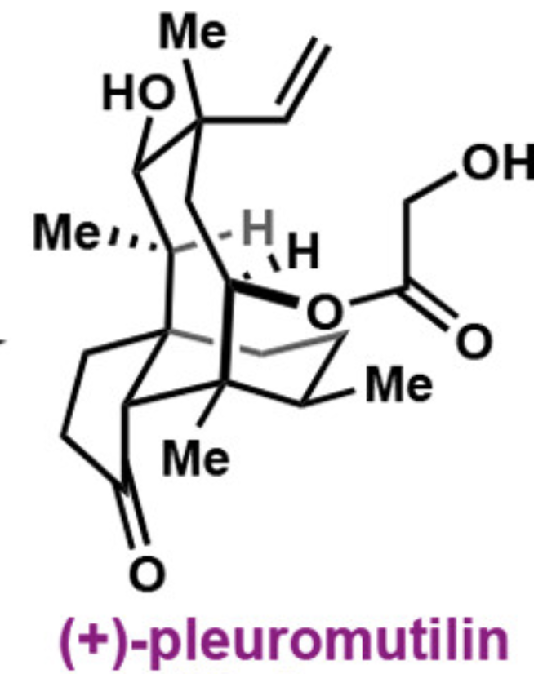
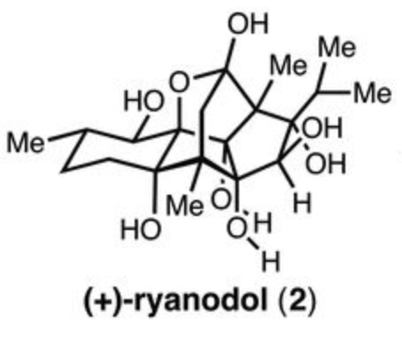
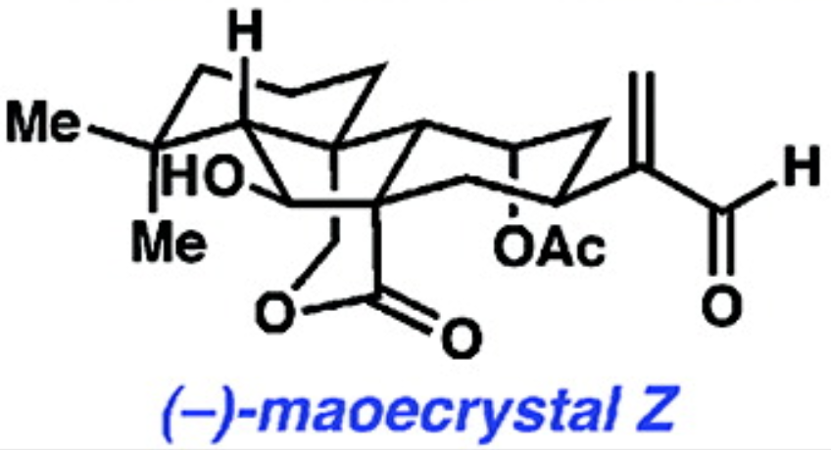
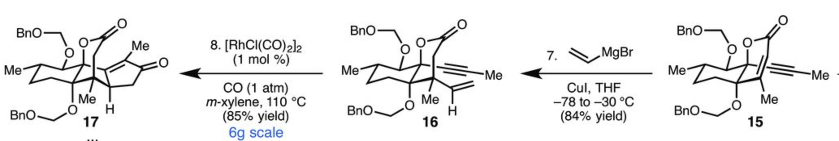
Professor Sarah Reisman
Department of Chemistry, California Institute of Technology
Born in Bar Harbor, Maine
B.A. Connecticut College, 2001
Ph.D. Yale University, 2006
Postdoctoral, Harvard University, 2008
Joined the Caltech faculty in 2008
Promoted to Full Professor, 2014
Pharmaceutical Company awards from:
Bristol-Myers Squibb, Eli Lilly, Novartis,
Amgen, Boehringer Ingelheim
Sloan Fellow
Dreyfus Teacher-Scholar
James King Award for Supporting Diversity

