Slide 1
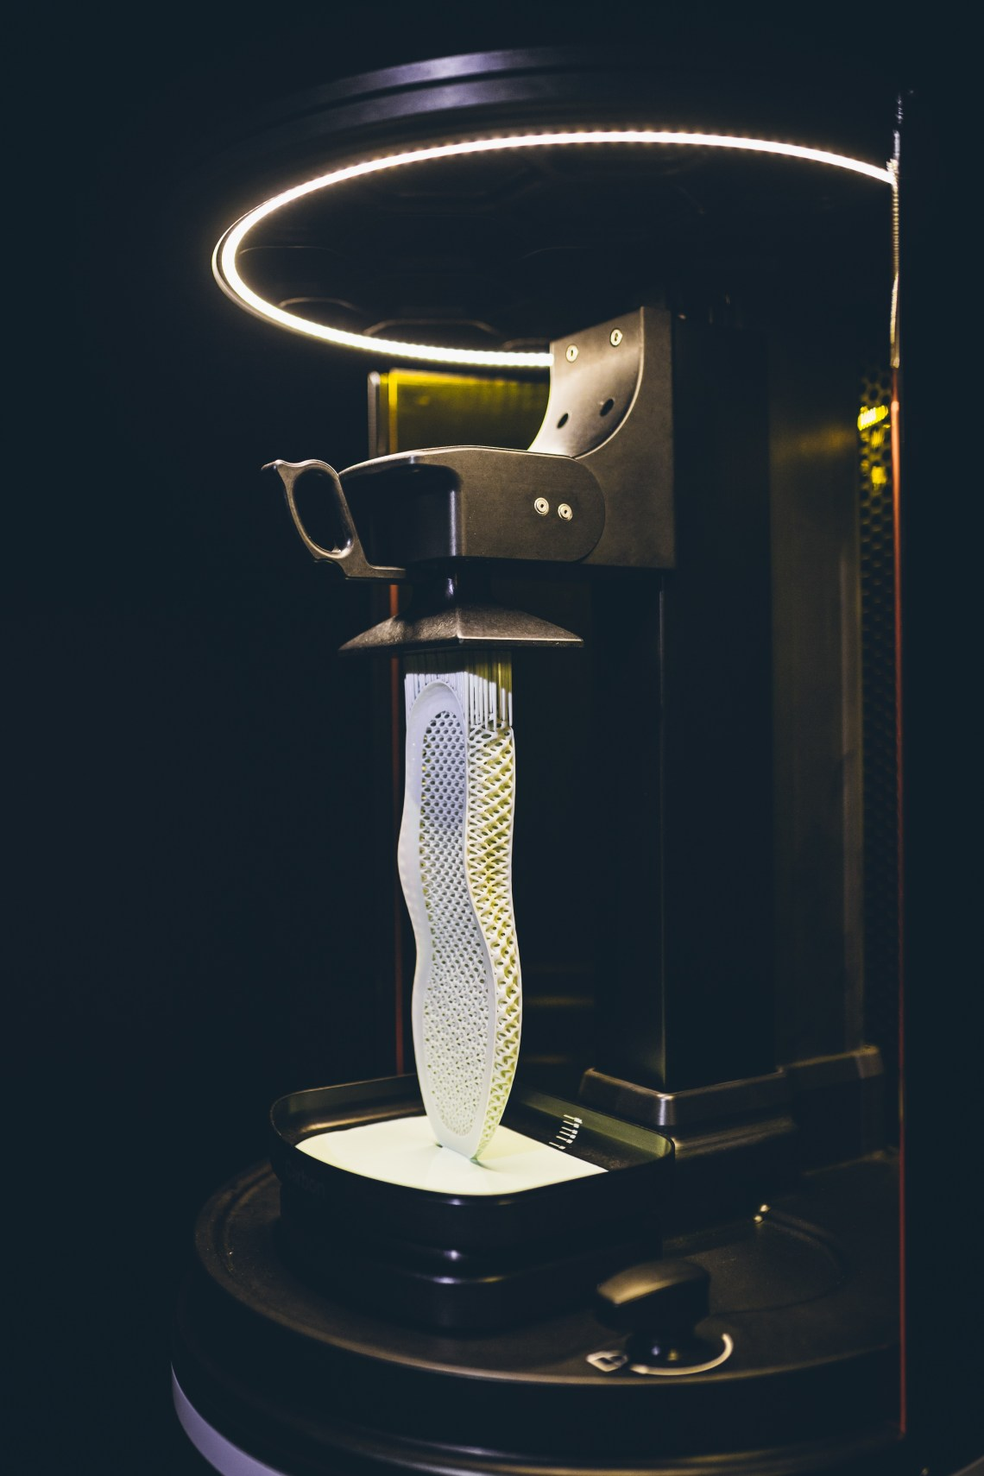
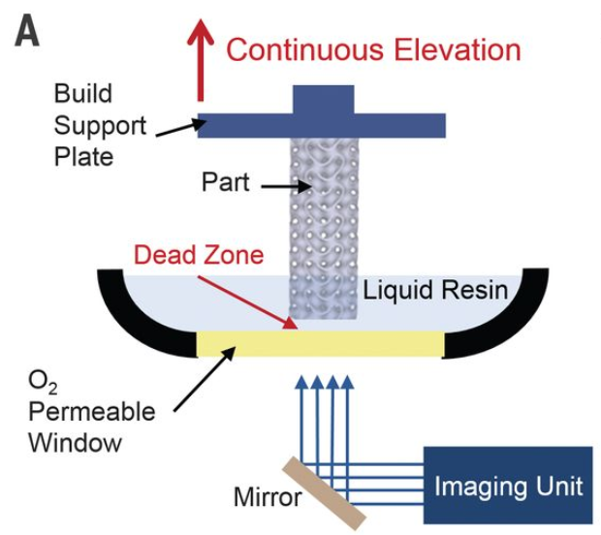
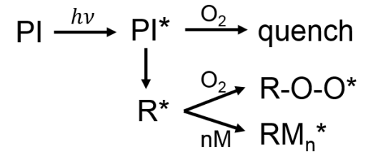
Professor Joe DeSimone
Department of Chemistry, University of North Carolina
B.S. Ursinus College
Ph.D. Virginia Tech
Founder and CEO of Carbon, Inc.
Member of:
National Academy of Sciences
National Academy of Medicine
National Academy of Engineering
Received:
US National Medal of Technology and Innovation
Lemelson-MIT Prize
Awesome Ted talk
and talk show clip

