Slide 1
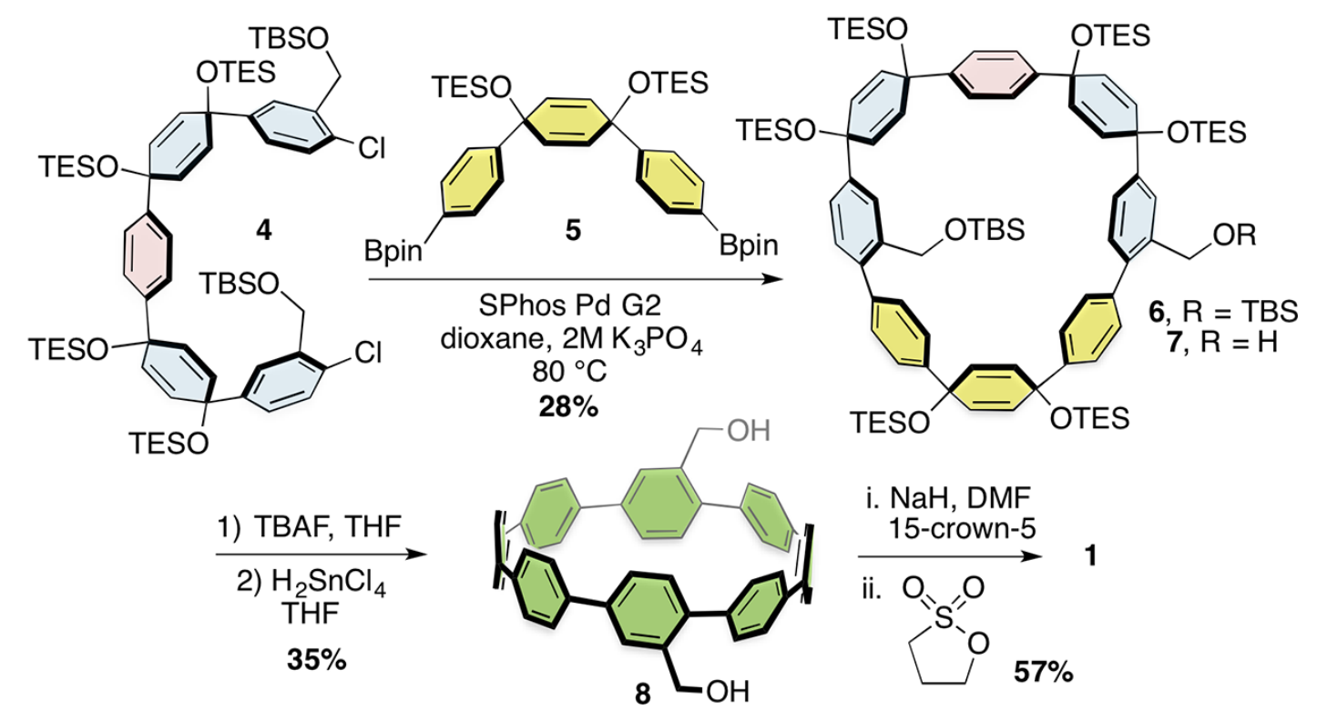
Professor Ramesh Jasti
Department of Chemistry, University of Oregon
Born in Concord, NC (also JM’s birthplace)
1st Generation in U.S.
B.S. University of North Carolina
Ph.D. University of California at Irvine
Postdoctoral, UC-Berkeley
Faculty positions at Boston University and University of Oregon
NSF CAREER Award
Sloan Fellow
Dreyfus Teacher Scholar Award
Fellow Duke basketball hater

