Slide 1
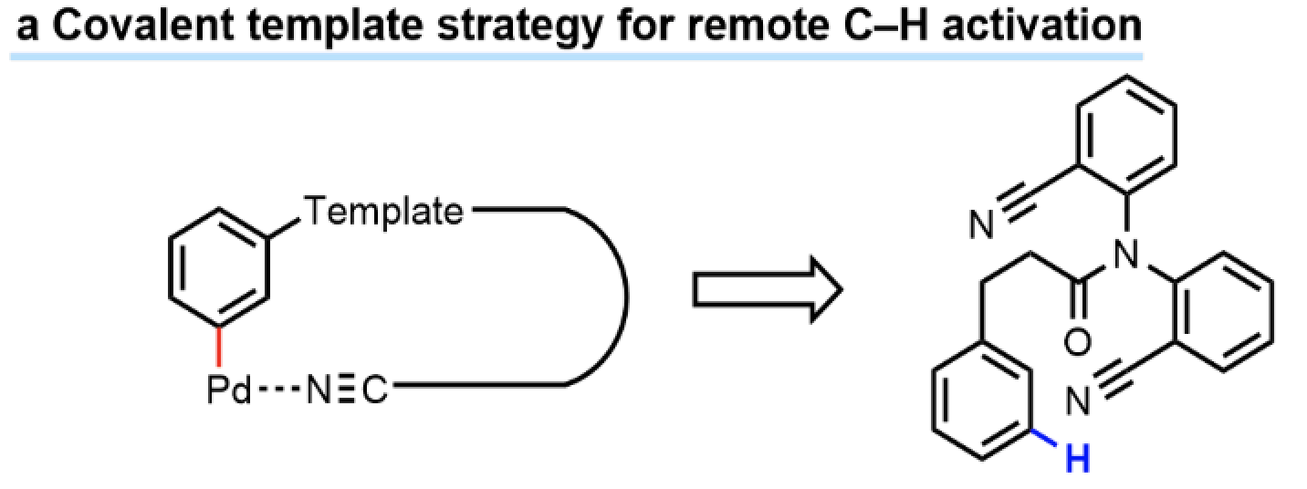
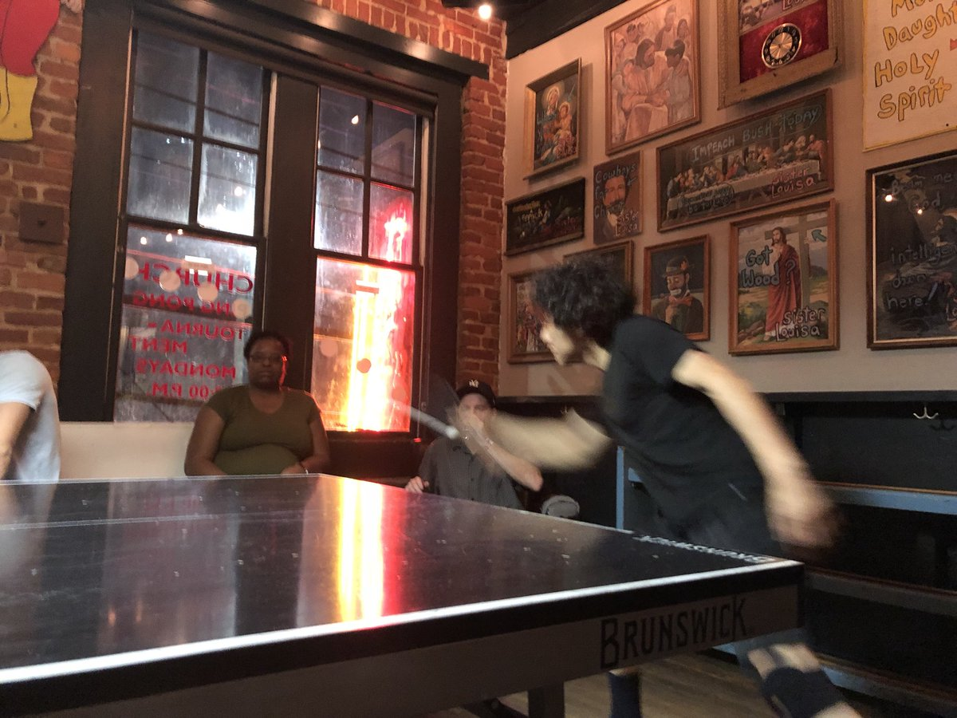
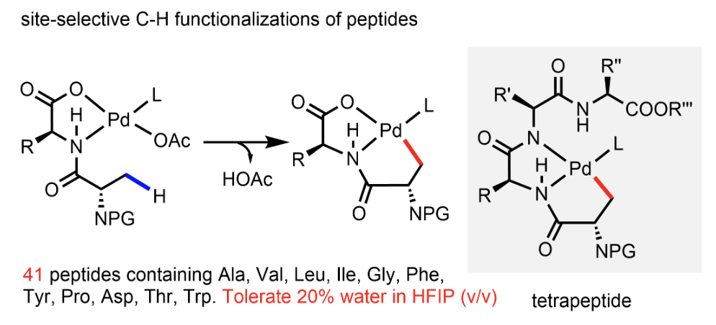
Professor Jin-Quan Yu
Department of Chemistry, the Scripps Research Institute
B.S. East China Normal University, 1987
M.S. Shanghai Institute of Organic Chemistry, 1988
M. S. Guangzhou Institute of Chemistry, 1990
Ph.D. Cambridge University, 1999
Postdoctoral Harvard University, 2002
Faculty positions at Brandeis and Scripps
MacArthur Genius Award Winner
Raymond and Beverly Sackler Prize
Elias J. Corey Award
Master Ping-Pong Champion

